Slide 1

Flockbusters
Analyzing & Predicting Bird Flu Outbreaks in the U.S.
Caleb Kelson, Christopher Davis, Katie Craig, Madhavi Nithianandam, Matthew Ward, Mary Pulley
Notes:
Caleb

Slide 2

What Is Bird Flu?
EXECUTIVE SUMMARY
Bird flu (aka: Avian Influenza; aka: Highly Pathogenic Avian Influenza (HPAI)) is an Influenza A virus affecting birds, with strains like H5N1 and H7N9 occasionally infecting humans. Transmission occurs through contact with infected birds or surfaces, with rare human-to-human spread.
Symptoms include fever, cough, and severe respiratory issues.
Outbreaks pose economic and pandemic level risks, requiring global monitoring by WHO and CDC.
Notes:
Caleb

Slide 3
The questions we’re looking to answer:
EXECUTIVE SUMMARY
Can we predict future outbreaks of Avian flu based on historic data using a times series model?
Can we group related outbreaks by their qualities across the United States?
Notes:
Caleb

Slide 4

Data Collection
OVERVIEW OF DATA COLLECTION, CLEAN-UP, AND EXPLORATION
We collected data from the WHO, CDC, and GISAID (Global Initiative on Sharing All Influenza Data) to effectively train our models.
The data we used to train our models generally ranged from 2021 to mid-February 2025, just prior to the CDC halting outbreak updates.
Notes:
Mary: Collecting this data was difficult. If you haven’t heard, the CDC has stopped releasing updates regarding ongoing outbreaks at the request of the president. We were able to collate historical data and preserve valuable Bird Flu data before it could be removed from the CDC’s website.

Slide 5
Our Approach…
Day 1
Day 5
Days 2, 3, 4
Identify Problem &
Data Sources
Visualization &
Presentation
Preprocessing & Testing
Models for Best Fit
Notes:
Christopher: We had a difficult time making the base dataframe with bird flu data as there were multiple viable datasets, all with great information but lacking common features among them that required us really have to break down each data set to observe the trends we were looking to document. This resulted in a lot of preprocessing for days 2-4 until Matt and Mary were able to format the data!

Slide 6
Binary Classification Models
Logistic
Regression
Random Forest Classifier
Flockbusters
Notes:
Matthew:
To start, we attempted to implement two different binary classification models.
Unsupervised learning typically deals with unlabeled data, meaning the model does not have predefined class labels to learn from. However, binary classification can still be applied in unsupervised learning using Clustering-Based Binary Classification.

Slide 7
Binary Classification Model for Outbreak Prediction:
Random Forest Classifier
Flockbusters
This analysis tackles a binary classification problem to predict bird flu outbreaks using a Random Forest Classifier. Various hyperparameter tuning methods are explored to optimize the model performance.
Notes:
Matthew:
Maybe skip… just read slide. rfc is an ensemble learning method for classification, regression and other tasks that operates by constructing a multitude of decision trees at training time. For classification tasks, the output of the random forest is the class selected by most trees. For regression tasks, the mean or average prediction of the individual trees is returned.
Data Preprocessing
The dataset is loaded, and weather and geographic features are extracted.
Data balancing is performed by sampling non-outbreak cases to ensure a fair comparison.
A train-test split is applied to prepare data for model training and evaluation.

Slide 8
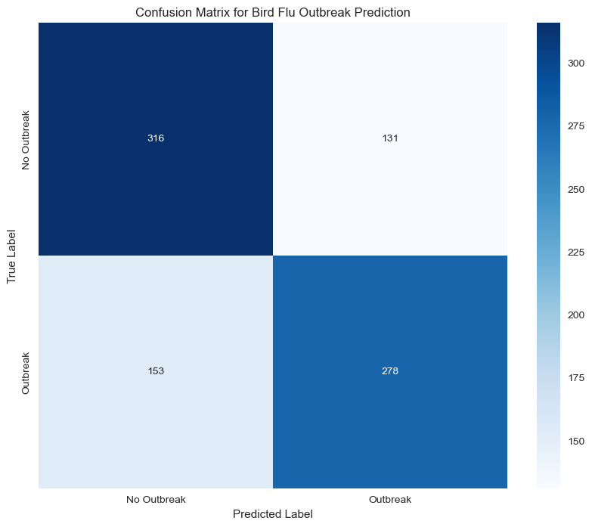
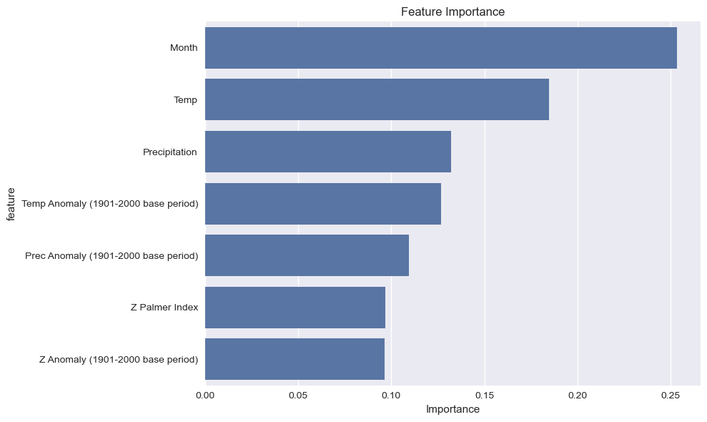
Confusion Matrix and Scoring
Notes:
Matthew:
Once those initial steps are complete, we trained a Random Forest Classifier, then generated a Confusion matrix, which illustrates:
True Positives (TP): Correctly predicted outbreaks.
True Negatives (TN): Correctly predicted non-outbreak cases.
False Positives (FP): Incorrectly predicted outbreaks.
False Negatives (FN): Missed outbreak cases.
The performance metrics help us assess whether improvements are substantial or marginal.
Performance Metrics:
Sensitivity (0.6450 or 64.50%): Of all actual outbreaks, the model correctly identified 64.50%. This means it catches about two-thirds of real outbreaks, but misses roughly one-third.
Specificity (0.7069 or 70.69%): Of all non-outbreak cases, the model correctly identified 70.69%. This indicates good performance in avoiding false alarms.
Precision (0.6797 or 67.97%): When the model predicts an outbreak, it's right about 68% of the time.
Overall Interpretation:
The model shows balanced performance but with room for improvement. It's slightly better at identifying non-outbreak situations (specificity) than catching actual outbreaks (sensitivity). The precision suggests that when the model raises an alarm, it's right more often than not, but there's still a significant false alarm rate. From a public health perspective, the false negative rate (missed outbreaks) might be the most concerning metric, as missing an outbreak could have serious consequences.
Feature Importance Visualization
A bar plot is used to highlight the most significant weather and geographic features that impact predictions. This helps in interpreting the model and understanding which environmental factors contribute to bird flu outbreaks.
Interpreting Feature Importance Graph
Features with higher importance values have a greater influence on the model's predictions.
Weather-related variables (such as temperature, humidity, and precipitation) seem to be key indicators of outbreaks.
This insight can be valuable for public health agencies to focus on specific environmental conditions that correlate with outbreaks.

Slide 9
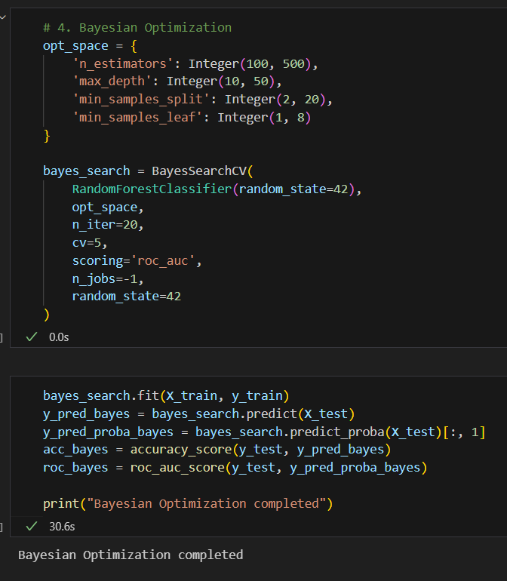
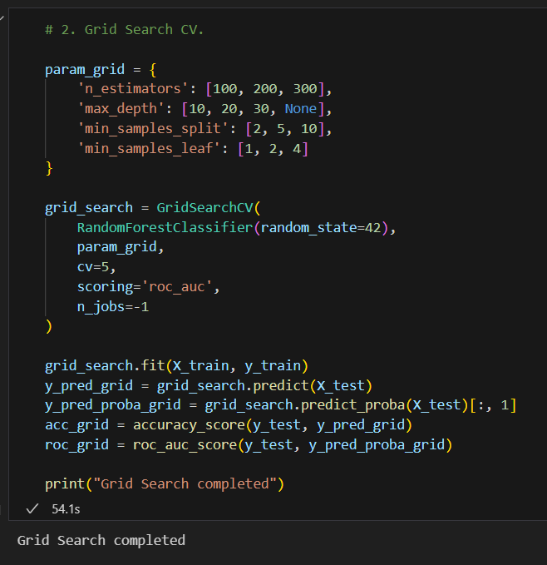
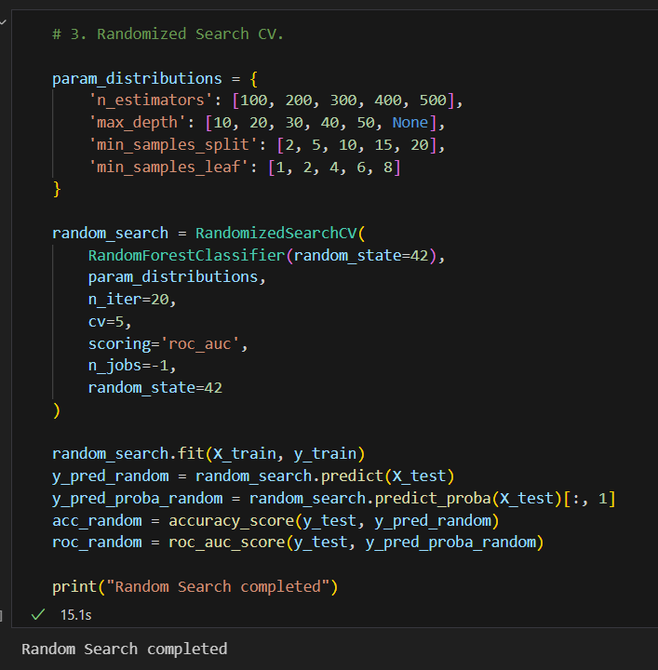
Code for Optimization
Flockbusters
Notes:
Matthew:
Just hyperparameters Modeling & Hyperparameter Tuning
As mentioned, the core model used is Random Forest Classifier, and three distinct hyperparameter tuning methods are tested:
Grid Search Cross-Validation (Grid Search CV) – Exhaustively searches a manually specified set of hyperparameters.
Randomized Search Cross-Validation (Randomized Search CV) – Randomly samples hyperparameters from predefined distributions.
Bayesian Optimization – Uses probabilistic models to efficiently search for the best hyperparameters.

Slide 10
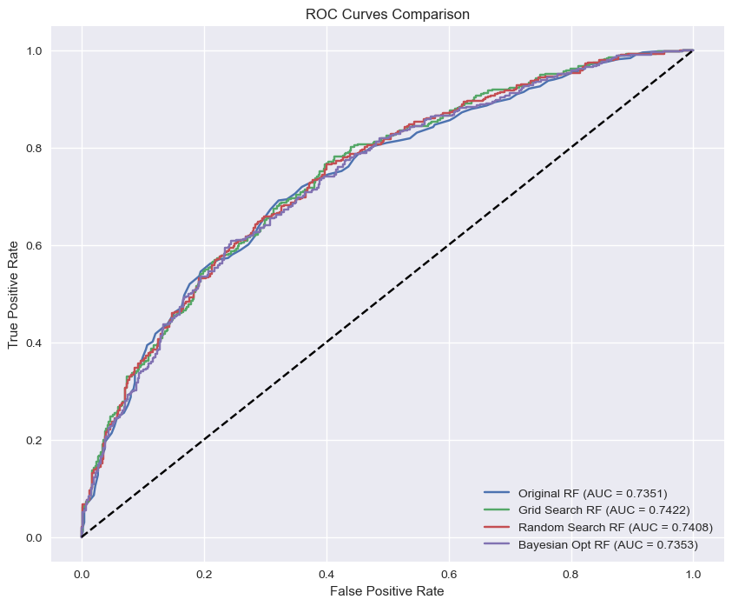
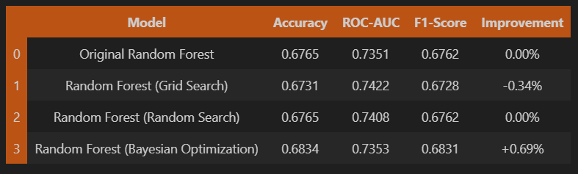
Confusion Matrix and Scoring
Notes:
Matthew:
Evaluation Metrics
Accuracy: Measures overall correctness of predictions.
ROC-AUC Score: Evaluates how well the model distinguishes between classes.
F1-Score: Balances precision and recall for classification performance.
Each model's improvement over the baseline Random Forest classifier is calculated.
Key Observations from Performance Table
Bayesian Optimization achieved the highest improvement (+0.69%) in accuracy.
Grid Search CV produced the highest ROC-AUC score (0.7422).
Randomized Search CV improved ROC-AUC but did not enhance accuracy.
Improvements were relatively small, indicating that the original Random Forest model was already well-optimized.
4. Conclusions & Recommendations
Findings
The analysis demonstrates the effectiveness of employing different hyperparameter tuning methods to enhance the Random Forest model.
It highlights the significance of specific weather features in predicting bird flu outbreaks.
The analysis provides a robust framework for similar binary classification tasks.
Overall, the original Random Forest model was already well-optimized, as improvements were modest.

Slide 11
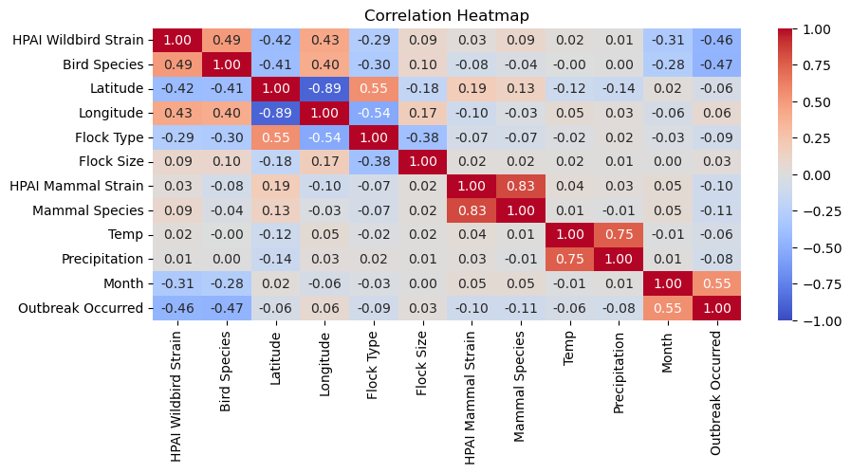
Correlation Heatmap
Notes:
Madhavi: Here is our correlation matrix
Key Observations from the Correlation Matrix:
Month and Outbreak Occurred (0.55 correlation):
A moderate positive correlation suggests that outbreaks may occur more frequently during specific months, potentially correlating with seasonal patterns (e.g., migratory periods).
HPAI Mammal Strain and Mammal Species (0.83 correlation):
HPAI Mammal Strain and Mammal Species have a high positive correlation (0.83), which suggests that that specific mammal species are more prone to certain HPAI strains.
Flock Type and Latitude (0.55 correlation):
Flock Type and Latitude have a moderate positive correlation, indicating that certain types of flocks might be located at specific latitudes.
HPAI Wildbird Strain and Latitude (0.43 correlation):
The HPAI Strain_x (Wild bird strain) has a moderate positive correlation with the Longitude which means certain bird species are specific to that longitudinal locations.

Slide 12

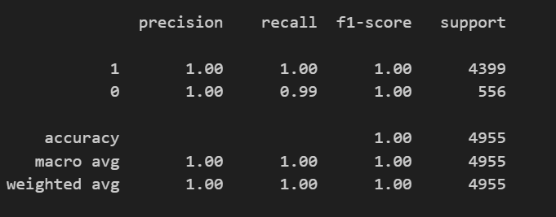
Binary Classification Model for Outbreak Prediction:
Logistic Regression
Confusion Matrix
Classification Report
Notes:
Madhavi: Binary Classification with Logistic Regression
Implementation
- The logistic regression model was built using the `LogisticRegression` class from scikit-learn.
- The model was trained on an encoded dataset with the binary target variable "Outbreak Occurred" representing whether an outbreak took place.
Model Evaluation Metrics
- **Accuracy Score:** Overall proportion of correctly classified instances.
- **Precision:** The proportion of true positive predictions among all positive predictions.
- **Recall:** The proportion of true positive predictions among all actual positive cases.
- **F1-Score:** A balance between precision and recall.
- **ROC-AUC Score:** Represents the trade-off between the true positive rate and false positive rate.
Key Findings and Visualizations
- The logistic regression model achieved competitive scores across the evaluation metrics, indicating its effectiveness in predicting outbreaks.
- A confusion matrix was generated to see the breakdown of correct and incorrect predictions.
- ROC precision scores were generated to further validate the model’s performance.
- Feature importance analysis was performed to highlight the most influential predictors in the classification task.
Conclusions
- The logistic regression model shows promising performance for H5N1 outbreak prediction.
- Metrics such as ROC-AUC, precision, and recall suggest the model is well-balanced in identifying outbreaks.
- Further feature engineering and validation on additional datasets are recommended to enhance precision and ensure robustness for practical deployment.

Slide 13
Forecasting Bird Flu Outbreak (ARIMA)
Flockbusters
The purpose of this code is to analyze the temporal patterns and characteristics of HPAI outbreaks using the provided datasets.
The modeling approach focuses on time series analysis, including decomposition and feature engineering, to gain insights into the data.
Notes:
Matthew:
After binary classification, we tried time-series forecasting to see if we could predict an outbreak of cases. To do this, we used Arima: (AutoRegressive Integrated Moving Average)
ARIMA is a statistical time series forecasting model. It is based on three main components:
AR (AutoRegression): Uses past values to predict future ones.
I (Integrated): Differencing is applied to make the time series stationary.
MA (Moving Average): Uses past forecast errors to improve predictions.
Requires manual tuning of parameters (p, d, q) or automated selection using AIC/BIC.
Works well for stationary or differenced stationary time series.
I’m sure you’re wondering… the main difference with Prophet is that ARIMA need stationary data, while Prophet excels with flexible, non-stationary data. Ideal for business (i.e. stock analysis) purposes.

Slide 14
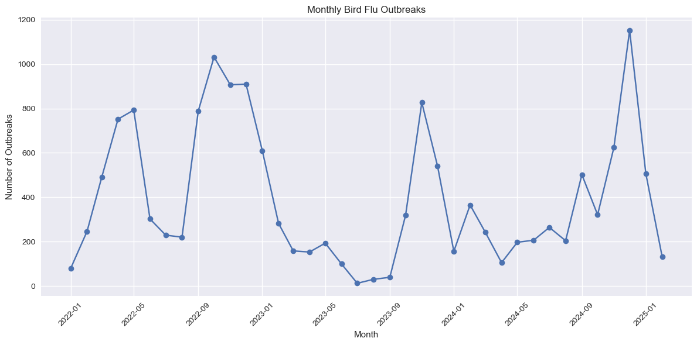
Bird Flu Outbreaks - Historical Data & Forecast
Notes:
Matthew: First, a time series plot is created showing the historical monthly bird flu outbreaks. Imports and Data Loading:
The code starts by importing various Python libraries for data manipulation, visualization, and time series analysis, such as Pandas, NumPy, Matplotlib, Seaborn, and statsmodels.
It then loads several CSV files containing data related to HPAI outbreaks, including flocks, livestock, mammals, wild birds, and weather data.
Data Preprocessing:
The code converts the 'Outbreak Date' column in each dataset to a datetime format.
It then aggregates the cases by date for each dataset (wild birds, mammals, livestock, and flocks) and sets the 'Outbreak Date' as the index.
The datasets are resampled to a daily frequency, and missing values are filled with zeros.
Feature Engineering:
The code creates additional features for the time series analysis, such as day of the week, quarter, month, year, day of the year, and rolling mean and standard deviation over a 7-day window.
Time Series Decomposition:
The code performs time series decomposition on the aggregated datasets using the seasonal_decompose function from statsmodels.
This allows the analysis of the trend, seasonality, and residual components of the time series.

Slide 15
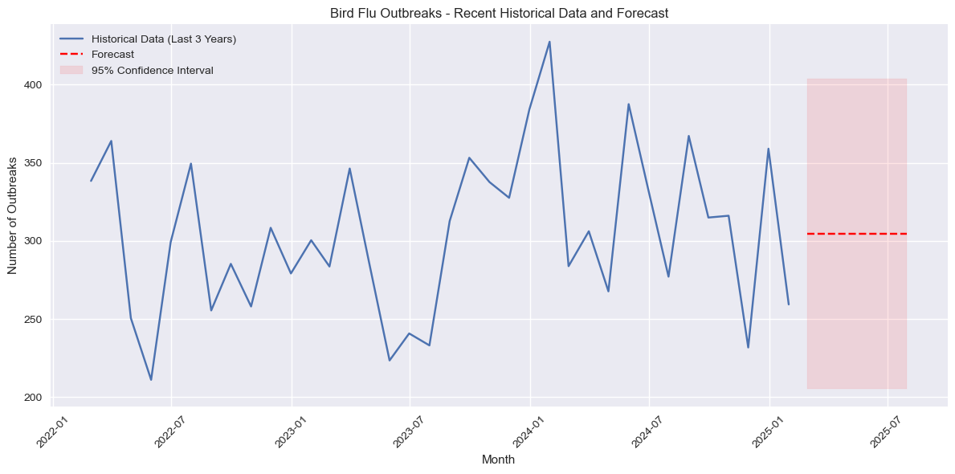
Bird Flu Outbreaks - Historical Data & Forecast
Notes:
Matthew:
Finally, the ARIMA model is fitted to the outbreak data (the forecast is generated for 6 months ahead). Then, the visualization combines both historical data and forecasts.
The final visualization is particularly important as it shows:
Historical data plotted as a solid line
6-month forecast shown as a red dashed line
Clear labeling of axes with months on the x-axis and number of outbreaks on the y-axis
The visualization shows the forecast with the 95% confidence interval shaded in light red around the forecast line. The confidence interval represents the range where we can be 95% confident that the true number of outbreaks will fall (in this case, between 200 and 400 cases per month over the next 6 months).

Slide 16
Outbreak Analysis with Weather & Species Data
Flockbusters
This analysis employs unsupervised machine learning—specifically, Principal Component Analysis (PCA) and K-Means clustering—to explore and group U.S. states based on environmental conditions and outbreak characteristics associated with Bird Flu.
The goal was to uncover underlying patterns that might influence the spread and severity of outbreaks.
Notes:
Matthew:
That is:
To explore the relationship between HPAI outbreaks and various factors such as temperature, precipitation, and drought conditions.
To identify clusters of states with similar characteristics in terms of HPAI outbreaks and associated factors.
To gain insights into the factors that may contribute to the spread and severity of HPAI outbreaks.
Modeling & Clustering Approach is as follows:
Feature Preparation: Features are scaled using StandardScaler to ensure they are on a similar scale.
Elbow Analysis: An elbow analysis is performed to determine the optimal number of clusters.
PCA and K-means Clustering: PCA is then applied to the scaled features to reduce the dimensionality, and K-means clustering is performed on the transformed data to identify the 4 clusters.

Slide 17
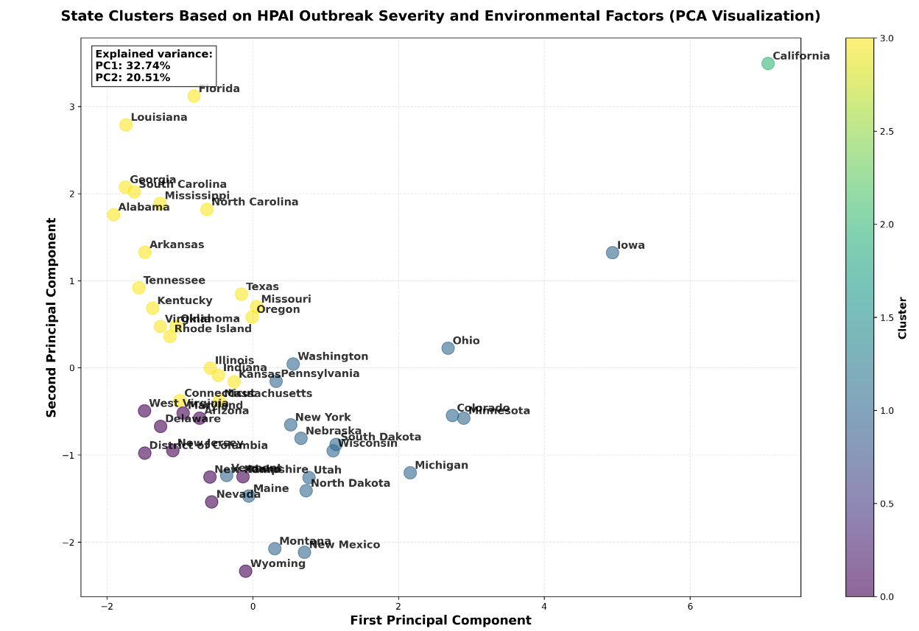
PCA Clustering: Outbreak Analysis with Weather & Species Data
Notes:
Matthew:
Key Findings and Conclusions
2. The PCA and K-means clustering identify 4 distinct clusters of states based on the HPAI outbreak characteristics and associated factors.
3. The clusters likely represent groups of states with similar patterns in terms of temperature, precipitation, drought conditions, and the number and severity of HPAI outbreaks in wild birds, livestock, and mammals.
4. The analysis provides insights into the factors that may contribute to the spread and severity of HPAI outbreaks, which can inform disease prevention and control strategies.
Overall, this analysis demonstrates a comprehensive approach to analyzing HPAI outbreaks and their relationship with various environmental and flock-level factors, using PCA and K-means clustering to identify meaningful patterns and groups of states.
### Conclusions
1. **Optimal Clustering:**
The elbow analysis supports the selection of 4 clusters, balancing the complexity and variance captured in the data.
2. **Distinct Groupings:**
PCA and K-means clustering work together to reveal discrete clusters of states, each representing distinct patterns in outbreak and environmental variables.
3. **Insightful Patterns:**
The clusters indicate that factors such as temperature, precipitation, drought conditions, and outbreak metrics are interrelated, providing valuable insights into how these elements may jointly influence the spread and severity of HPAI outbreaks.
—--- # **Principal Component Analysis (PCA) and Clustering Summary**
## **PCA Overview**
dimensionality reduction technique used in Machine Learning to transform high-dimensional data into a lower-dimensional space while preserving as much variance as possible.
### **PCA1 (First Principal Component):**
- Represents the largest source of variation in the data.
- Strongly influenced by outbreak severity (`Birds Affected`, `Flock Size`).
- States further to the right on the plot have larger outbreaks.
### **PCA2 (Second Principal Component):**
- Represents the second-largest source of variation.
- Heavily influenced by temperature and precipitation.
- States higher up on the plot tend to have higher temperatures and precipitation.
Here’s what a PCA1 value of 32.74 and a PCA2 value of 20.51 indicate:
PCA1 (32.74%): This means that the first principal component explains 32.74% of the total variance in your dataset. This component is the most significant in capturing the data's spread.
PCA2 (20.51%): The second principal component accounts for 20.51% of the variance, capturing the second most important pattern in the data after PCA1.
Interpretation:
Together, PCA1 + PCA2 explain 53.25% of the total variance, meaning that these two components capture just over half of the patterns in your dataset.
If you are using PCA for dimensionality reduction, retaining at least PCA1 and PCA2 would keep a significant portion of the data’s structure.
The higher the PCA values, the more variance is retained, making them more informative. ## **Conclusions:**
The identified clusters provide valuable insights into different patterns of HPAI transmission events:
- **Wild Bird outbreaks** typically involve small flock sizes with few birds affected.
- **Livestock outbreaks** involve larger flocks but show different levels of bird impact.
- **Flock-based outbreaks** show the highest number of affected birds.
## Analysis Results
1. The elbow curve helps determine the optimal number of clusters (k=4)
2. PCA reveals the main components of variation in the data
3. The clustering shows distinct patterns in HPAI outbreaks across states
4. Feature importance shows which variables contribute most to the patterns
5. The top affected states by bird count are clearly identified
These insights are critical for understanding the dynamics of HPAI outbreaks and can support targeted disease prevention and control strategies.

Slide 18
If we had more time…
ADDITIONAL QUESTIONS & FUTURE RESEARCH
Create a front end interface
application for our model.
Understand how genomic data
impacts bird flu.
Incorporate other data like
land usage statistics & migratory data.
Save the birdies!
Notes:
Katie:

Slide 19
Conclusions
Avian bird flu is more prevalent than we thought and is a serious threat to public health.
Many environmental factors are contributing to the outbreak impact
ARIMA is a useful time series model to create predictions on complex data models with many features.
Notes:
Christopher:
Avian bird flu is more prevalent than we thought and we are seeing more mutations and spread to mammals as time goes on.
Preprocessing took the majority of our class time to create a master dataframe and understand how our problem is a machine learning project versus a data analysis.
Challenges with this type of data?: To ensure that critical patterns are highlighted rather than being masked by irrelevant differences in feature scales or influenced by noise.
ARIMA is a useful time series model to create predictions and data visualizations which we used for the first time in this class.

Slide 20
Questions
Pop Quiz: How many birds did you find in the presentation?!
Notes:
Christopher: 22!

Slide 21
Link to our repository
CLICK BELOW TO LEARN MORE!
https://github.com/MaryPulley/Project_2/tree/main
Notes:
Link to repository: https://github.com/MaryPulley/Project_2/tree/main

